Slide 1
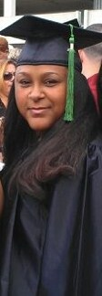
EXCHANGE
AMERICA VS ITALY
Anne

Slide 2
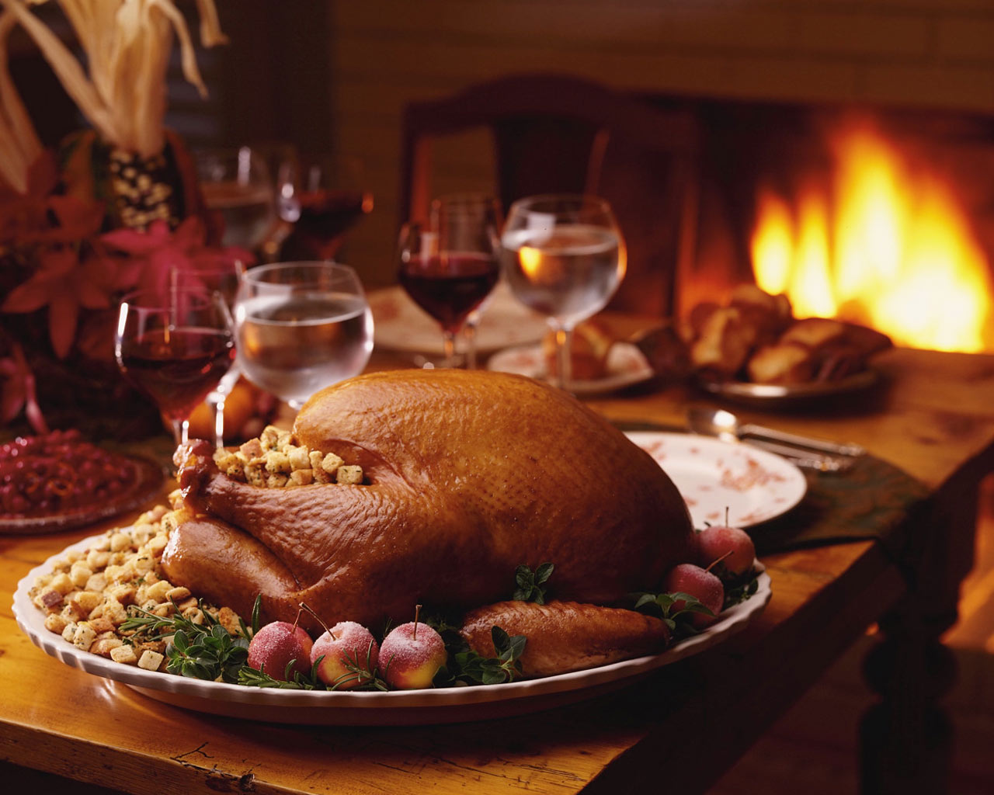
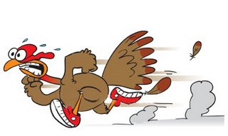
THANKSGIVING DAY
It is celebrated on the 4th Thursday of November every year.

Slide 3
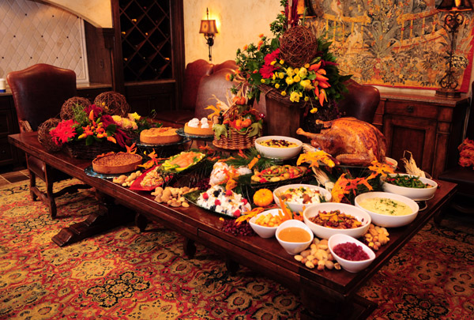
DINNER

Slide 4
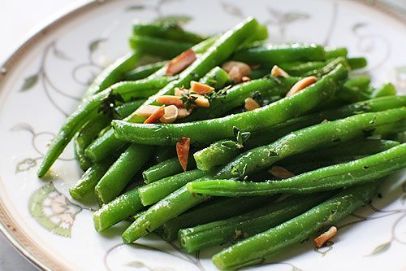
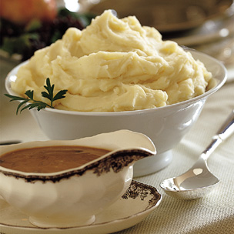
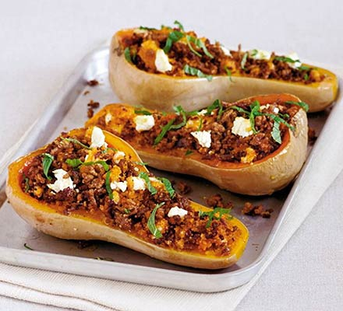
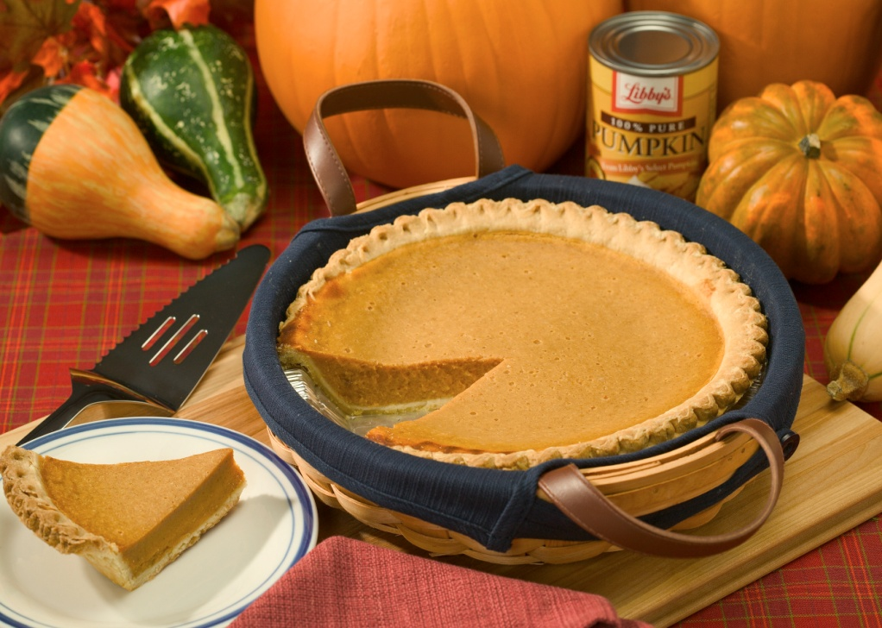

Slide 5
ORIGINS OF THANKSGIVING
It started back in the 1600 with the Pilgrims
They moved to America, the Native Americans cooked for them, taught them how to build houses, how to grow food etc..
They wanted to give thanks to God and for the many good things.

Slide 6
All the malls are open super early and people get good bargain.

Slide 7
THE ORIGIN OF THE NAME “black Friday”
The day ‘s name originated in phinadelphia
originally it was used to describe the heavy and disruptive pedestrian and vehicle traffic which would occur on the day after Thanksgiving.
ALTERNATIVE EXPLANATION →
retailers traditionally operated at a financial loss ("in the red") from January through November, and "Black Friday" indicates the point at which retailers begin to turn a profit, or "in the black".

Slide 8
Cyber Monday
The following Monday stores offer great deals but only Online: it is called Cyber Monday.

