Slide 1
LIFE IN THE U.S. AND IN ITALY
American vs Italian culture project

Slide 2
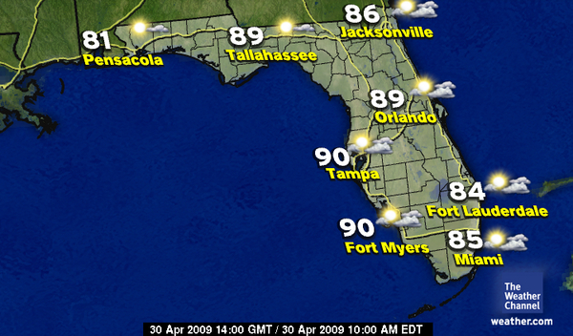
W
E
A
T
H
E
R
“The weather here in Miami is super hot! But thankfully it is starting to feel like winter already”.
Deivis
Florida | Northern Italy
The climate is tempered since the state isn’t very distant from the ocean. In the northern and central part of the state the climate is humid subtropical, whereas southern coastal areas have a tropical climate. In the summer, high temperatures seldom exceed 38°C., whereas in winter the state rarely encounters freezing temperatures. Even though Florida’s nickname is “Sunshine State”, the state has one of the highest average precipitation levels of any state. Florida is also known to be the most hurricane-prone state. | The climate is marked by hot and wet summers, whereas winters are moderately cold. The precipitation is higher and there is no dry season. Average temperatures are around 2°C in the winter and around 25°C in the summer.

Slide 3
DAILY ROUTINE of a high school student
“I would also love to know a little more about Italy and the daily routine of a typical Italian student”.
Deivis
 | the U.S. | Italy
Breakfast | Some American students have breakfast at home. Vending machines are also a major source of food for students. | Italian students usually have breakfast at home with their family.
What time does school begin? | In both countries school begins at around 8.00 a.m., depending on the area.
Means of transport | In the States all schools have school buses. When students turn 16 and get a driving licence, they often drive to school. | The majority of Italian students catch the bus, whereas others are driven by their parents or walk to school.

Slide 4
 | the U.S. | Italy
Lunch | Most schools have a canteen. | Most Italian students eat at home.
What time does school end? | Students don’t go to school on Saturdays, so they leave later than Italian students (at around 2.00-3.00 p.m.) | Some students go to school also on Saturday,s so they can leave early on weekdays (at around 12.00-1.00 p.m.), whereas the others, who don't go to school on Saturdays, usually go home at 2.00 p.m.

Slide 5
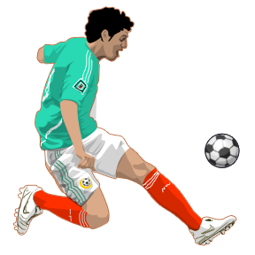
SPORTS
Sports play an important role in American society. They enjoy tremendous popularity but more important they are vehicles for transmitting values like justice, fair play, and teamwork. Sports have contributed to racial and social integration and over history have been a "social glue" bonding the country together.
 | the U.S. | Italy
#1 | Football | Soccer
#2 | Baseball | Basketball
#3 | Basketball | Volleyball
#4 | Hockey | Cycling
#5 | Soccer | Waterpolo
#6 | Golf | Wrestling
#7 | Tennis | Athletics
#8 | Motorsports | Tennis
#9 | Wrestling | Golf
#10 | Martial arts | Rugby
“I have a big interest in action sports, which is what I love to do in my spare time”.
Deivis
Most popular sports in the U.S. and in Italy

Slide 6
STEREOTYPES
Americans are fat and lazy
All Americans dress like cowboys
To American people family comes first
Most Americans live either in skyscrapers or on farms
Americans divorce repeatedly
Americans have very complicated private lives
A person has a good chance of being killed in the street in the U.S., therefore most people there carry a gun
Americans only eat hamburgers, hot dogs, popcorn, and Coke
Italians are short and dark
Italians dress well
The Mafia
Public affection
Big families
Italians are mama’s boys and live with their parents until they’re 40
Italians are good lovers
Italian men are rude
Italians eat a lot of pasta
All Italians gesticulate a lot when they speak
Italians don’t speak English
the U.S.
Italy

Slide 7
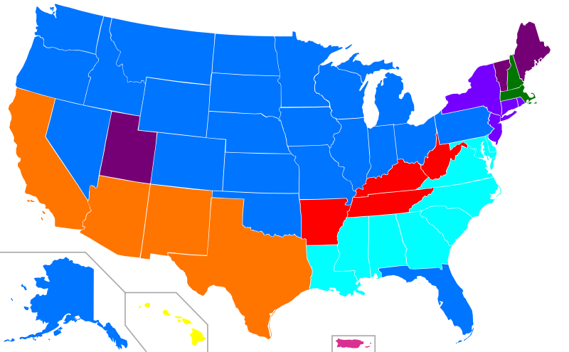
ETHNICITY in the U.S.
“Here in Miami, there are so many different cultures that you never really know where the person you are talking to is from”.
Deivis
Most of the inhabitants of the U.S.’s ancestors weren’t actually born there: in fact, indigenous peoples lived in the United States for thousands of years and developed complex cultures before European colonists began to arrive.
German American Mexican Irish African
Italian English Japanese Puerto Rican

Slide 8
NATIONALITIES in ITALY
Foreign population resident in Italy

Slide 9
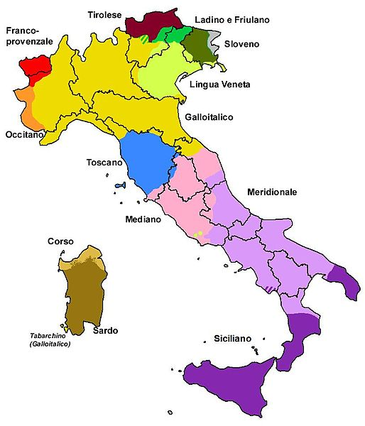
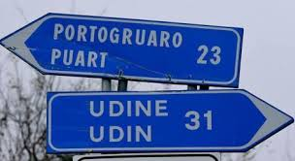
LANGUAGES and DIALECTS in ITALY
In Italy, several linguistic groups are legally recognised like French, German, Ladin and Slovene.
Even if Italian is the only national language, there are lots of different dialects in the country. They may vary depending on the region and can be so different, even two Italians could find it difficult to understand one another.
Street signs are often written in both Italian and the regional dialect.
Elderly people are more likely to speak a dialect rather than Italian because that's how they used to communicate when they were young.
“Is Italian the only language that is really needed in Italy?”
Deivis

Slide 10
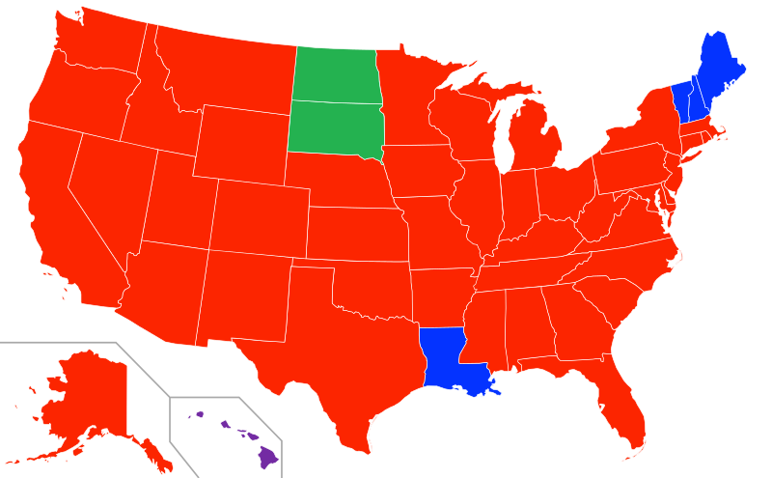
English is the first language in the U.S. Spanish is the second most common language in the country, followed by Chinese, French and German.
LANGUAGES in the U.S.
Spanish
French
German
Tagalog
(the 1° language of the Philippines)
Second most prevalent language in each US state.

Slide 11
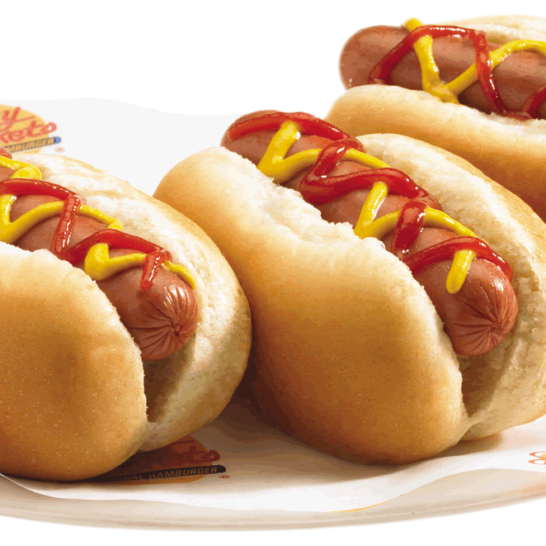
TYPICAL AMERICAN FOOD
Fast, junk, processed -- when it comes to American food, the country is best known for the stuff that's described by words better suited to greasy, grinding industrial output.
Some of the most popular American food products are hamburgers, hot dogs, cheeseburgers, apple pie, sweet potatoes, lemonade, caramel apples, coke, pancakes, chicken wings.

Slide 12
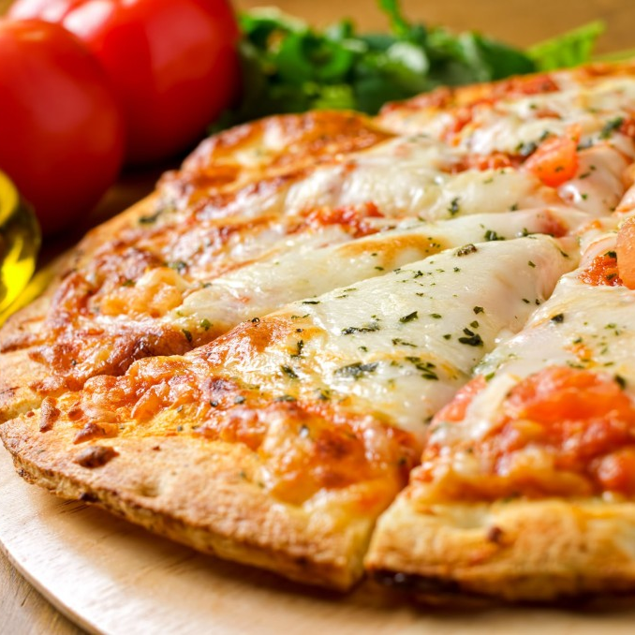
TYPICAL ITALIAN FOOD
Italian cuisine is strongly influenced by local history and traditions, as well as by the local and seasonal availability of products.
Some of the most popular Italian dishes are pizza, pasta, risotto, mozzarella cheese, grana cheese, Parma ham, panettone, polenta and baccalà.
Italy is also home of the oldest wine-producing regions in the world.

Slide 13
Sources:
http://en.wikipedia.org
http://travel.cnn.com/explorations/eat/b est-usa-travel/top-50-american-foods-513946
http://www.yourguidetoitaly.com/popular-foods-of-italy.html
http://educationnext.org/time-for-school
http://www.therichest.com/sports/most-popular-sports-in-america
http://incorporateinitaly.wordpress.com/2013/07/15/typical-italian-or-italian-stereotype
http://www15.uta.fi/FAST/US7/REF/us-stero.html
http://k1047.cbslocal.com/2013/05/18/top-10-stereotypes-about-americans
http://usa.usembassy.de/sports.html

