Slide 1



AMERICA VS ITALY
CULTURAL PROJECT

Slide 2
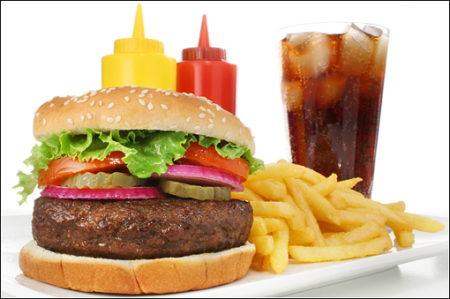
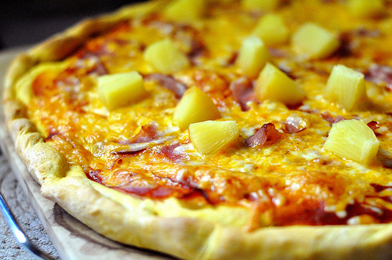
What do you think of us?
Prejudices and stereotypes - FOOD
* Italians love good food and wine (generally, the first word people link with Italy is pizza)
* Italian tablecloths are only white-red-checked
* some misunderstandings and atrocities: spaghetti and meatballs, pasta or pizza with chicken, pizza with pineapples
* American people eat lots of junk and greasy food
* they are very fat and almost everybody suffers from a “food-related” illness (mostly Obesity)
* Americans don't have a “food tradition” of their own

Slide 3
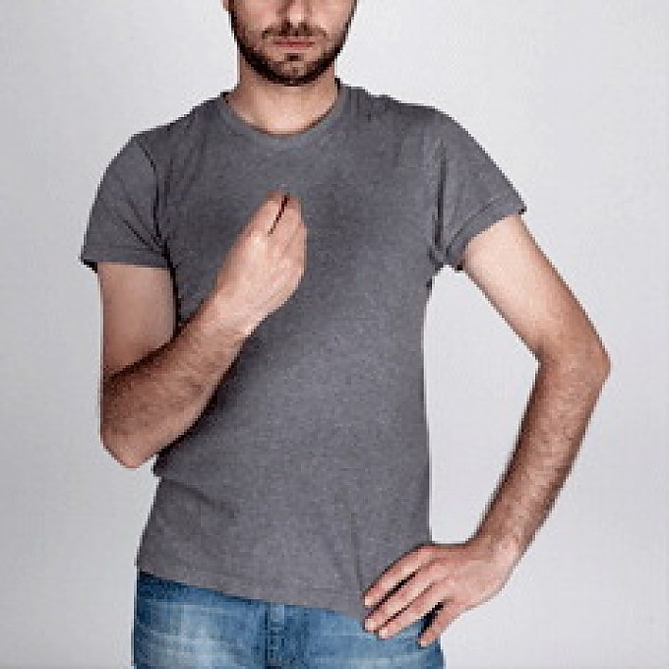

What do you think of us?
Prejudices and stereotypes - BEHAVIOUR
* “Italians are lazy since they take naps”, they have a very slow pace
* they are always late
* Italians are noisy and rude, but get really (even too much) formal when it comes to having guests
* Italians talk with their bodies
* American people love their country and are really proud of it, they're very patriotic
* they're said to be arrogant and think they're always the best
* Violence is very common in the US, since it's very easy to get a weapon

Slide 4
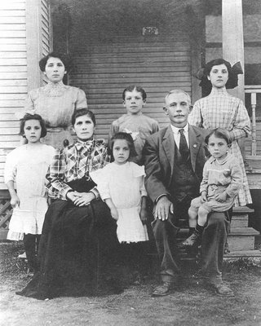

Family
Italy
The average family today is made up of one or two children, that’s to say we have no more families with a lot of children as fifty years ago (models like this sometimes survive in the South).

Slide 5
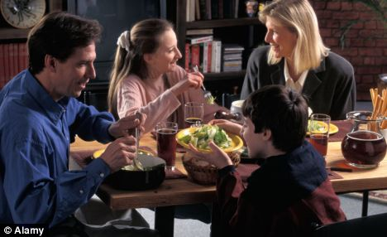
Though Italian families tend to be smaller now, they continue to spend a lot of time together and try to eat together at least one meal (which is usually dinner), to share the day's events.

Slide 6


America
Most American families are made up of parents and one or two children, and recently a large number of parents have chosen not to have children. Due to school and work schedules few families eat meals together.
The United States has a very high divorce rate and this typically leads to families being split.

Slide 7
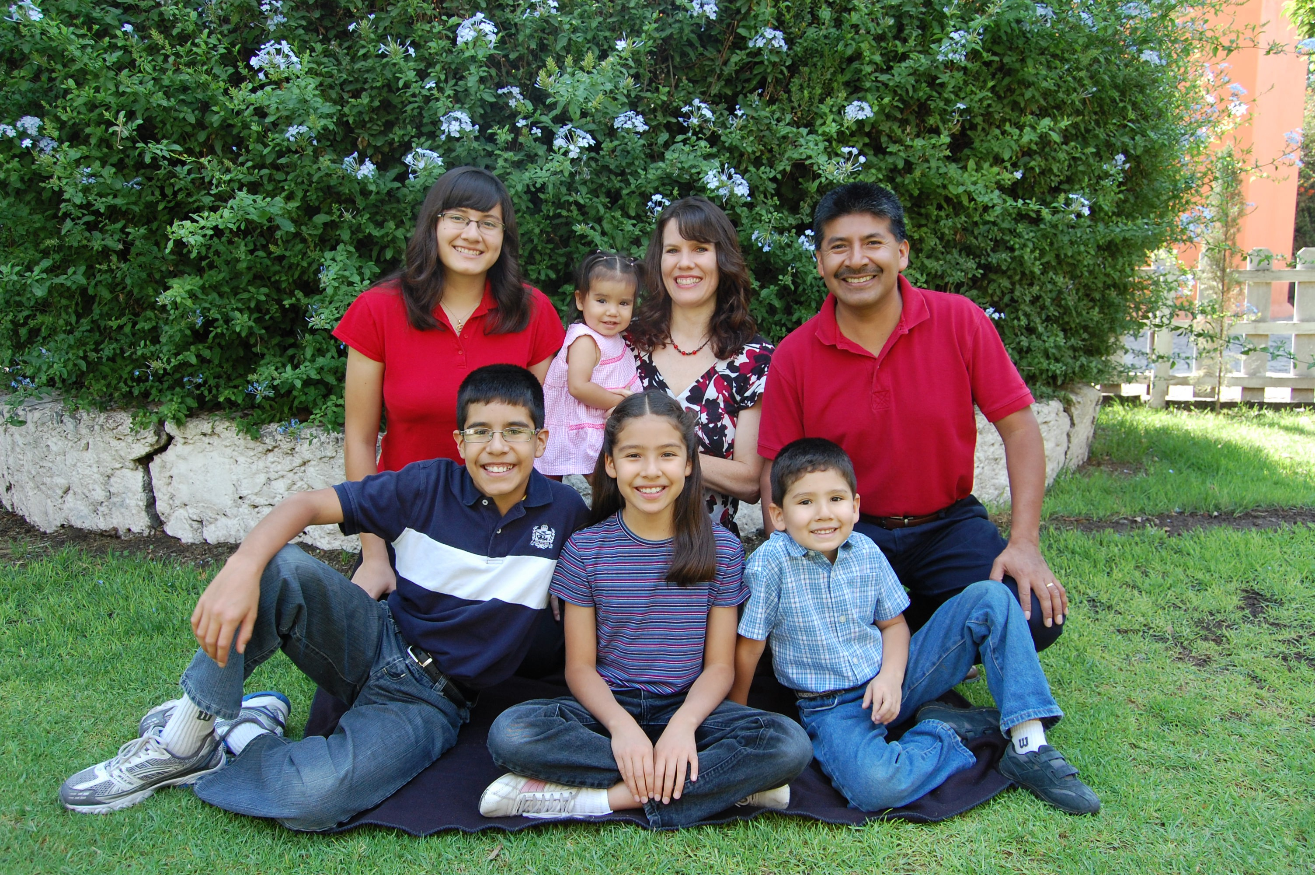
On the other hand, Latin families tend to be closer and larger, with the average of 3 children (or even up to 5). Because of traditions, Latin families tend to keep on sharing at least one meal together.

Slide 8

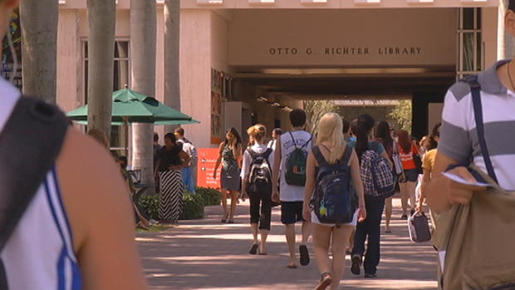
Latin teens typically like to stay home for college, whereas American families at the age of 18 tend to motivate the children to go away from home.
They feel like the children need to go off, make mistakes and create their own lives.

Slide 9

Project and presentation made by:
Camilla Frontini
Federica Rimoldi
3DL ISIS D. Crespi
Special thanks to our American partner:
Jason Fonseca
MDC Miami

