Slide 1
Florida
Pros and cons

Slide 2
Why Yes?
Yes, because there are many beautiful clean beaches, warm weather all the year round, lots of tourists, different opportunities, great colleges, Disney World, fresh oranges and grapefruits, amazing night life, and no boredom.
People like walking a lot, going shopping and also bike-riding. Good and healthy food is also a characteristic of this place.
Over 200 public institutions, colleges, universities, public universities and religiously-affiliated institutions can be found here

Slide 4
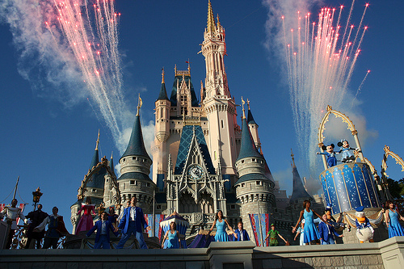
Disney World, is an entertainment complex that opened October 1, 1971, in Lake Buena Vista, Florida, and is the most visited attraction in the world, with attendance of 52.5 million annually. It is owned by The Walt Disney Company through its division Walt Disney Parks and Resorts.

Slide 6
Cons
The weather:
When it gets hot, it really gets HOT. (sometimes up to 40)
In summer it is often too humid
This weather results in too many mosquitos, snakes and lizards.
Not to mention the hurricane season: it rains intensively almost every day for at least 20 mins. This causes a plenty of tsunamis.
Money:
Everything costs a lot, you have to spend a fortune for many ordinary things.
Tourists:
Over the years, Florida has become too populated and now the sensation you get is that of an overcrowded place.

