Slide 1
HOLIDAYS & TRADITIONS

Slide 2
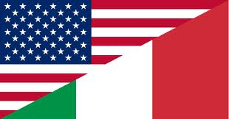
Our Project Beyond The Pond
Over the months since the 16th October we have joined the adventure of finding out about the American culture, thanks also to the technological progress. It’s amazing how emails allow us to connect each other from all over the world! Our pen pale was Eder Mendes, a 26 year-old boy from Miami.
The most interesting feature we have found is how Americans celebrate holidays and their traditions; so we have decided to focus on this topic.

Slide 3
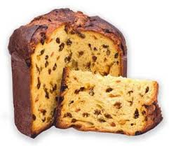
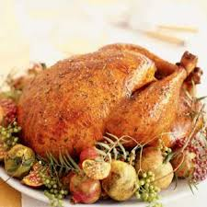
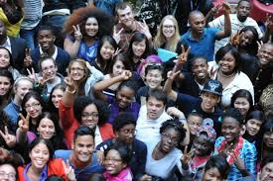
Our Consideration About The Project
What struck us the most is how American people are used to approaching to their festivities and holidays. For instance, Christmas in Italy is a very popular religious holiday, whereas in the U.S. there is a big issue whether this time of year should be officially celebrated as a Christian festival.
Moreover, In Italy holidays are special occasions to gather, celebrate and have special meals. By the way, for Italians food is part of life and it is particularly important; on the other hand, for Americans food is regarded as “fuel”, just a physical necessity.
We have also found out that Americans are a very close-knit community and they are proud of their traditions; Independence Day and Veterans Day, to name a few, play a big role for them and show their “patriotic soul”. Unlike the Italian ones, these festivities are very popular among young people; in Italy, on the other hand, the youth is not very keen on public holidays and even if they are celebrated, the don’t have a particular meaning for young people.

Slide 4
American holidays
Christmas
Thanksgiving Day
Martin Luther King Day
Veterans Day
Memorial Day
Independence Day
St.Valentine’s Day

Slide 5
Italian holidays
Christmas
Easter
Carnival
Epiphany
Liberation Day
Republic Day
Ferragosto

Slide 6
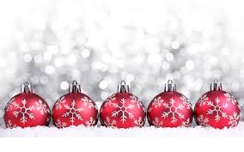
Christmas (25° december)
Italy
Usa
This holiday celebrates the birth of Jesus. In Italy it’s a very popular religious festival; during the Advent, the period before Christmas, people get ready for the coming of Christ.
Children are used to having a so called “Advent Calendar” and every day while they’re waiting for Christmas they open a box where they usually find a chocolate. We decorate the Christmas Tree and children write a letter to Santa Claus who will bring them gifts if they have behaved themselves.
On Christmas Eve we go to church (at midnight) and we attend the Mass. On Christmas day families gather, celebrate and have lunch together.
This holiday celebrates the birth of Jesus also in the USA. However there is a big argument whether this time of year should be officially celebrated as a Christian festival, because Christianity is only one among many religions. In public, Americans will often wish each other “Happy holidays!” rather than referring to the festival by name. Christmas is a day for families to get together and celebrate the birth of Christ where families exchange gifts to one another.
Actually most do not even celebrate the idea of that, they just see it as a day to exchange gifts and to spend time with friends and family. It’s a tradition to have a tree to decorate with ornaments and place the gifts in wrapping under the tree until Christmas morning when everyone gathers around to open the presents.

Slide 7
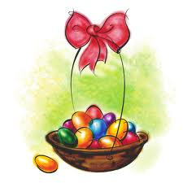
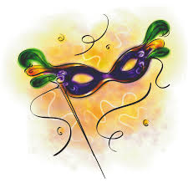
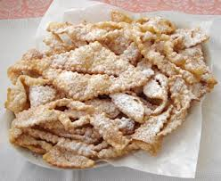
Italy
Easter: (in April or May, it depends on the day) for Christians is the most important festival, even though Christmas is more popular among Italians. It celebrates the resurrection of Christ on the third day after his crucifixion; it is preceded by Lent (in Italian Quaresima), a forty-day period of prayer and penance. It’s a tradition not to eat meat on Fridays. The last week of Lent is called Holy Week (Settimana Santa) and it includes Holy Thursday, commemorating the Last Supper of Christ and the foot washing, and Good Friday, commemorating the crucifixion and death of Jesus. Lots of children get a chocolate egg on the day of Easter which contains a little surprise.
Carnival: (the two days before the Lent) children use to dress up with traditional costumes (Pulcinella, Arlecchino, Colombina); they take part in parades through the town streets by throwing confetti. On these particular days you can eat some typical foods, such as Chiacchiere and Frittelle.

Slide 8
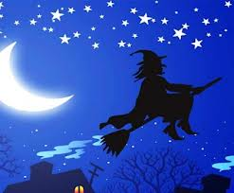
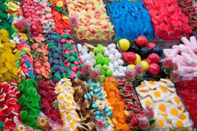
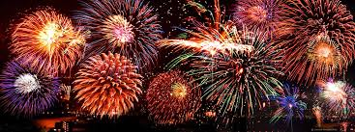
Italy
Epiphany: (6th January) it’s a Christian feast day that celebrates the visit of the Magi to the Baby Jesus. In the Italian popular folklore, the Befana, an old, wrinkled, ragged lady, visits the children on the eve of January 6 to fill their socks with candy and presents if they had been good or a lump of coal or dark candy if they had been bad.
Ferragosto: (15th August) The Catholic Church celebrates the Assumption of the Blessed Virgin Mary. After going to Church, families gather and have together barbecues in the gardens, thanks to the hot and usually sunny weather. At night beautiful fireworks light up the sky.

Slide 9
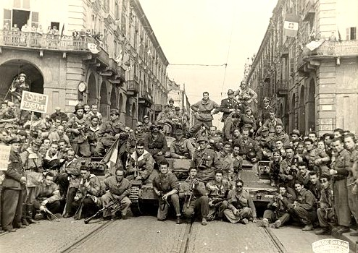
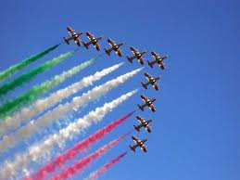
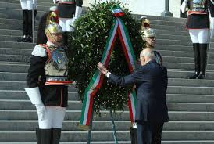
Italy
Liberation Day (25th April) it’s quite similar to the Independence Day; it marks the liberation of Italy from the Nazi occupation and the end of the dictator Benito Mussolini thanks to the insurrection in Northern Italy by the Italian Resistance Movement.
Republic Day (2nd June) this day commemorates the institutional referendum held in 1946, in which the Italian people were called to the polls to decide the form of government between the monarchy and the republic. Every year a military parade takes place in the centre of Rome, presided over by the President of the Italian Republic. The ceremony continues with musical performances by the band of the Italian Army, Italian Navy, Italian Air Force, the "Arma dei Carabinieri", State Police and the "Guardia di Finanza".

Slide 10
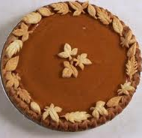
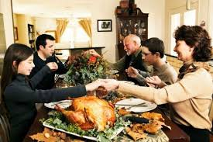
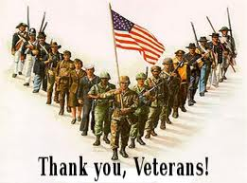
USA
Thanksgiving (4th Tuesday in November) In 1621 English settlers in Massachusets had a special meal to celebrate their first harvest after surviving a long hard winter. They sat down together with the Indians, who had helped them get through the first year. Today it’s one of the major celebrations in the USA and also Canada. Families travel hundreds of miles to share the traditional dinner of roast turkey followed by pumpkin pie.
Veterans Day (11th November) this day in late autumn remembers all the men and women who have served in the country’s armed forces in times of war.

Slide 11
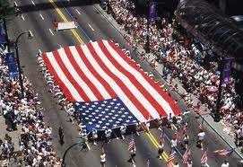
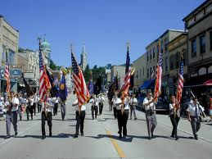
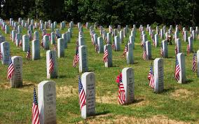
USA
Independence Day (4th July) this day celebrates the end of British colonial rule in 1776 and the creation of the United States of America.
Memorial Day (the last Monday in May) this began in 1868 as a day when people went to the graves of soldiers who had died in the American Civil War (1861-1865) to put flowers on them. Later it became a holiday dedicated to all those who died at war.

Slide 12
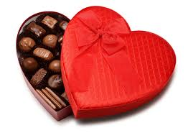
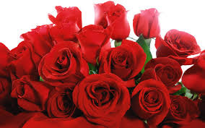
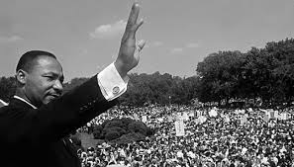
USA
St. Valentine’s Day (14th February) is the day on which couples celebrate their love for one another. It is usually a day of romance when people either celebrate their love or look to give a gift to someone they admire. Flowers and chocolates are the most popular gifts.
Martin Luther King (3^{rr} Monday in January) this holiday honours the civil rights leader who was assassinated by a gunman on April 4th in 1968. He demanded equal rights for black Americans. His most famous speech included the line : “I have a dream that the sons of former slaves and the sons of former slaves owners will sit together at the table of brotherhood”.

